Slide 1
CIS247C Course Project
Object Oriented Car Dealership Database

Slide 2
Details about me
Major: Computer Information Systems – Focused in Software Programming
Background: 1 year of scholastic experience in C++, 1-3 months of self-taught experience in Python
Career Goal: Become a Software Engineer for a leading technology company

Slide 3

Hypothetical Problem Statement
I am a consultant that was hired to create a vehicle dealership application
Needs to be able to showcase inputted information in an organized manner
Needs to be dynamic ( able to be changed easily and quickly)

Slide 4

Classes used to develop Database
I used 6 different Classes to assist in creating the application database
Each class has their own aspects to them, with several being child/parent classes of one another.

Slide 5
Visio Studio UML Diagram
I created a Visio UML Diagram to paint a picture of how the classes should correlate with each other.
The overall parent class, the vehicle class, will have the generic items that every vehicle would have:
VIN #, Make, Model, Year, Price
From there, I made every different class hold their own specific aspects of them.

Slide 6
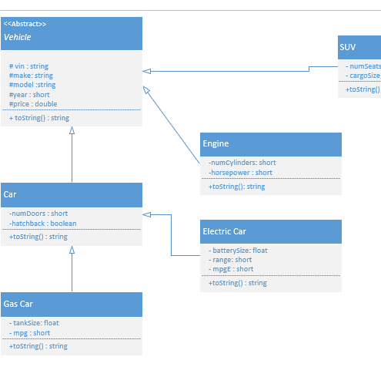
Visio Visual Breakdown

Slide 7
Aspects/Terminology of OOP used in Classes
Inheritance –All of my classes are inheriting attributes from another class
It is important to conduct proper data hiding to ensure variables don’t get accessed by unauthorized individuals
Polymorphism – Polymorphism allowed me to condense my coding and reuse lines of code with minor adjustments.

Slide 8
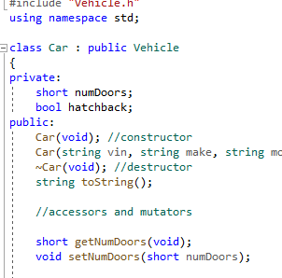
Data Hiding

Slide 9
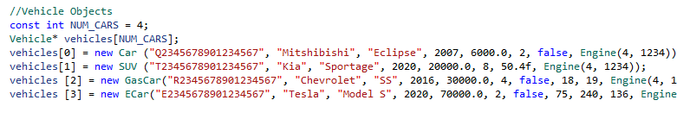
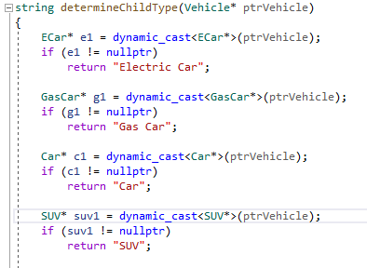
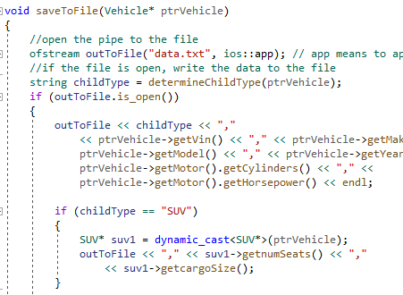
Polymorphism

Slide 10
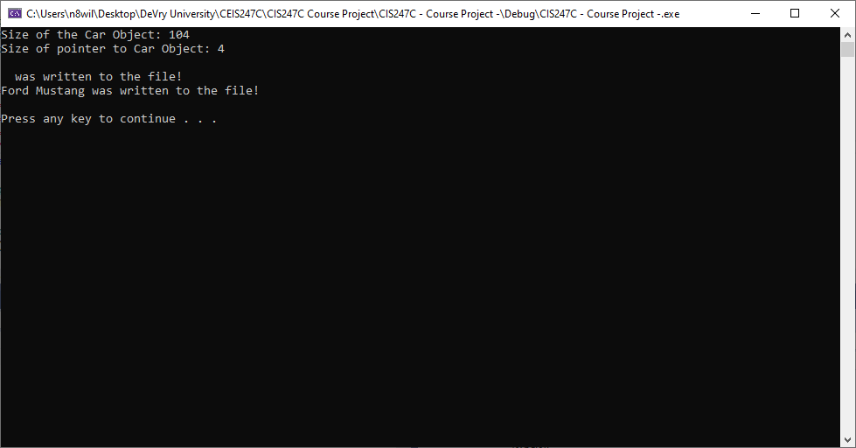
Problem/Bug that I faced during project creation

Slide 11
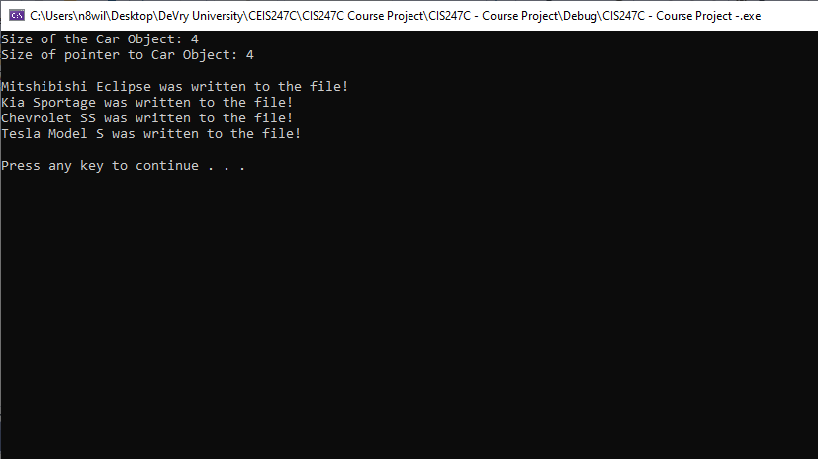
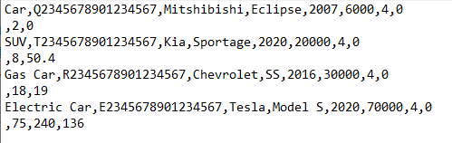
Conclusion

